Slide 1
End Time Scenarios
Part 1 – Where Do We Go When We Die?
Dr. Antwan Butler

Slide 2
Philosophies about death
Reincarnation – if you lived a good life you will come back in the form of another creature.
Ghost – you come back as a spirit and you live in the house where you used to dwell
Purgatory – go to a place of punishment until you paid your dues
Cease to Exist – when you breathe your last breath that there will be no more conscious existence

Slide 3

We are spirit beings
Humans will live on for eternity
Animals do not possess a soul
Notes:
God places his spirit and soul into the new body

Slide 4
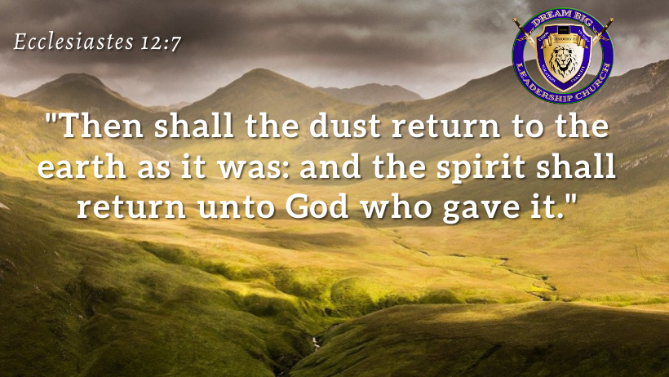

Slide 5
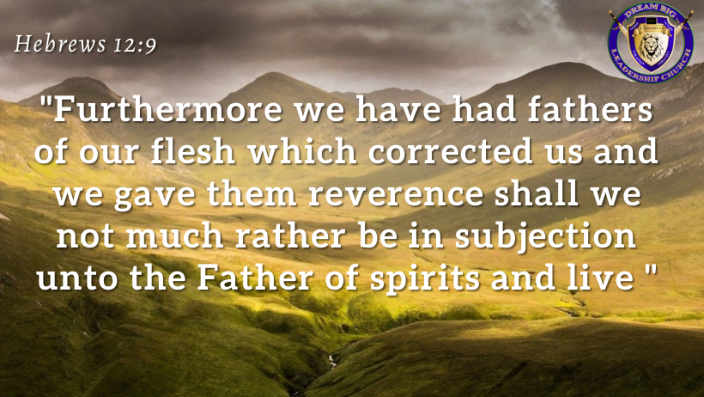

Slide 6


Slide 7
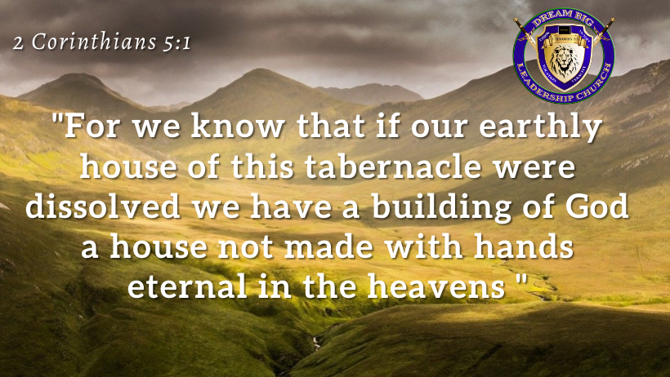

Slide 8
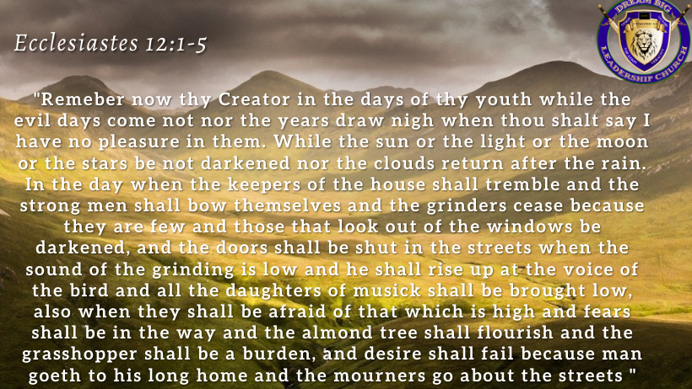

Slide 9
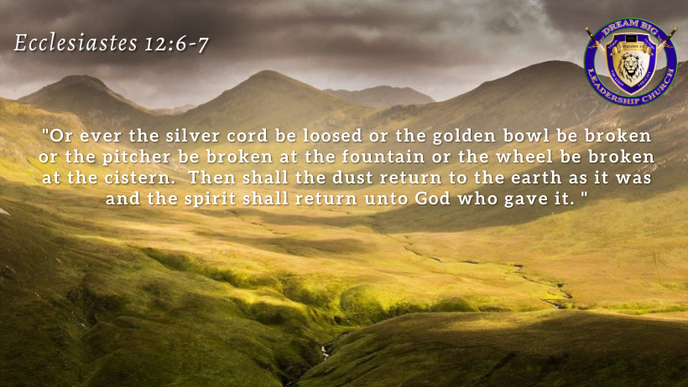

Slide 10
What happens when the physical body dies
Notes:
- we are going to get a lasting body

Slide 11
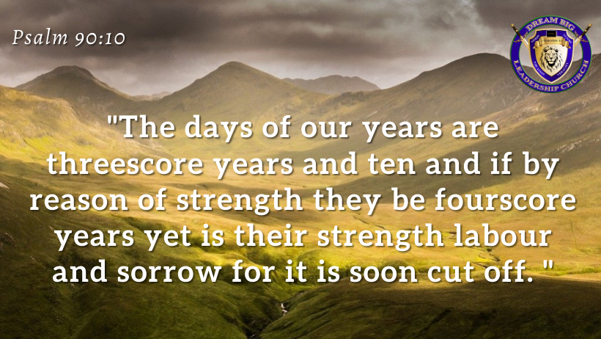

Slide 12
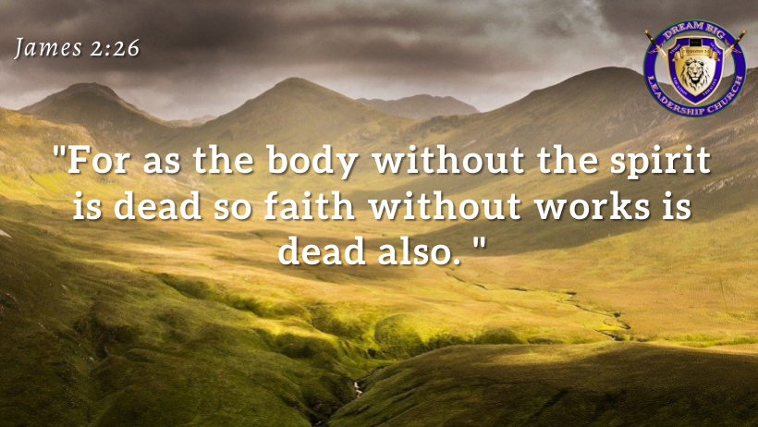

Slide 14
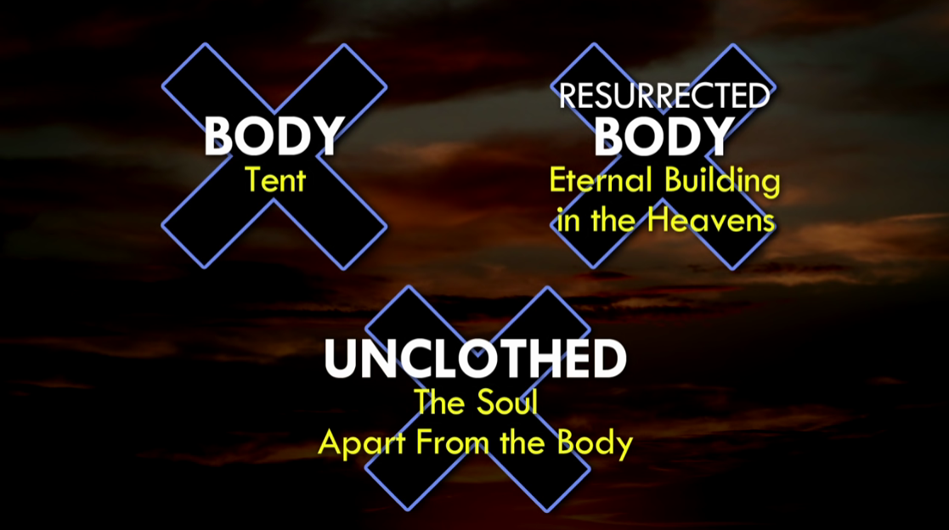
Notes:
When is the unclothing going to occur. Answer: When we die?

Slide 15
Hades
The Dwelling Place of the Dead
A Holding Place for Disembodied Spirits
Notes:
- The good and the bad both go to Hades
- the KJV translates this word as hell
- the Old Testament word is Sheol

Slide 16
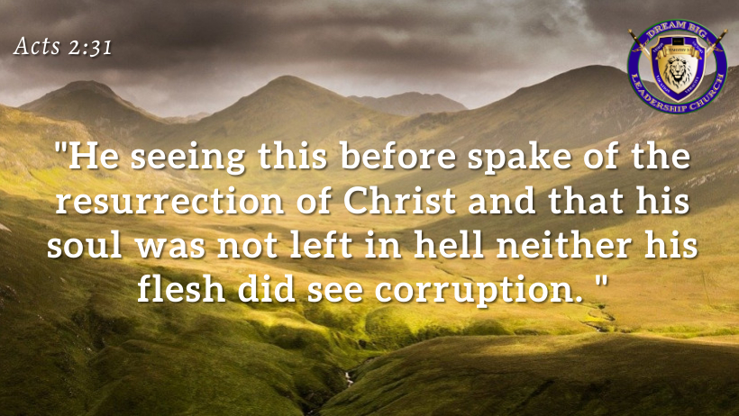

Slide 17

Paradise
Where believers go after death

Slide 18
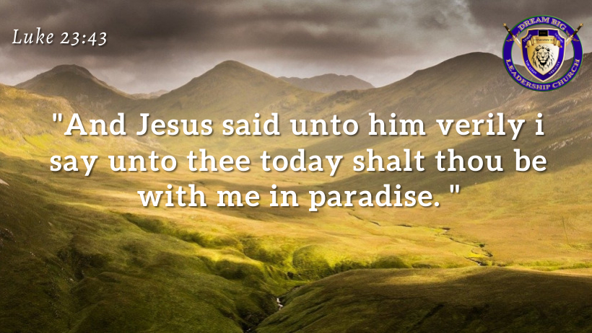

Slide 19
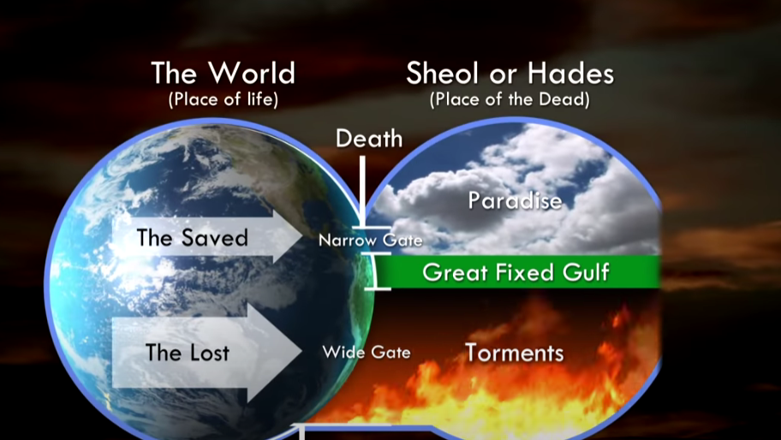
Notes:
Matthew 7:14 – “Enter ye in at the strait gate for wide is the gate and broad is the way that leadeth to destruction and many there be which go in thereat, because strait is the gate and narrow is the way which leadeth unto life and few there be that find it.”

Slide 20
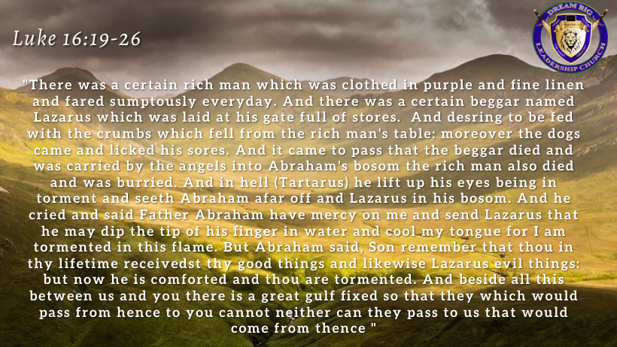

Slide 21
Abraham’s Bosom
The Part of Hades that the Righteous go to await Judgment
It is located in paradise
Notes:
Luke 16:15 says this is the place is where the righteous are comforted

Slide 22

Tartarus
Tartarus – the place of torment where judgment is awaited
;
Notes:
Luke 16:22, 23 – lift up his eyes being in torment (he is burning in fire and begging for forgiveness)
- every person who is lost is in this place suffering
- there is consciousness in the Hadean realm (there is no such thing as soul sleeping)

Slide 23
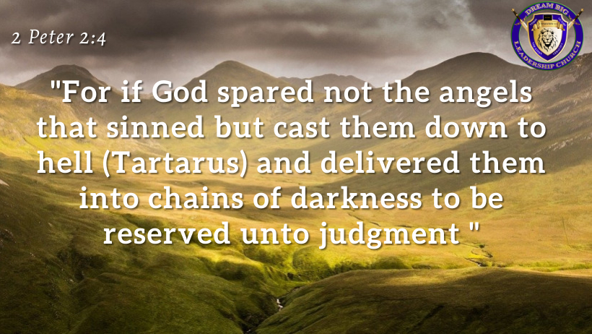

Slide 24
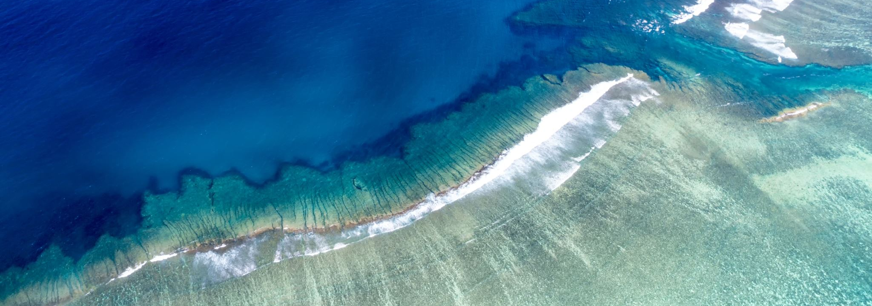
GREAT GULF
Once you are in paradise or in torment you are there to stay.

Slide 25

The Day of Judgment

Slide 26
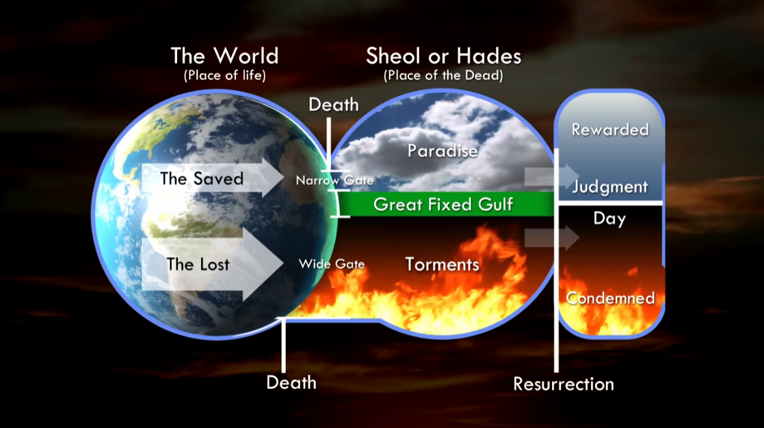
Notes:
On the day of judgment Hades will give up its bodies and the earth will give up its bodies

Slide 27
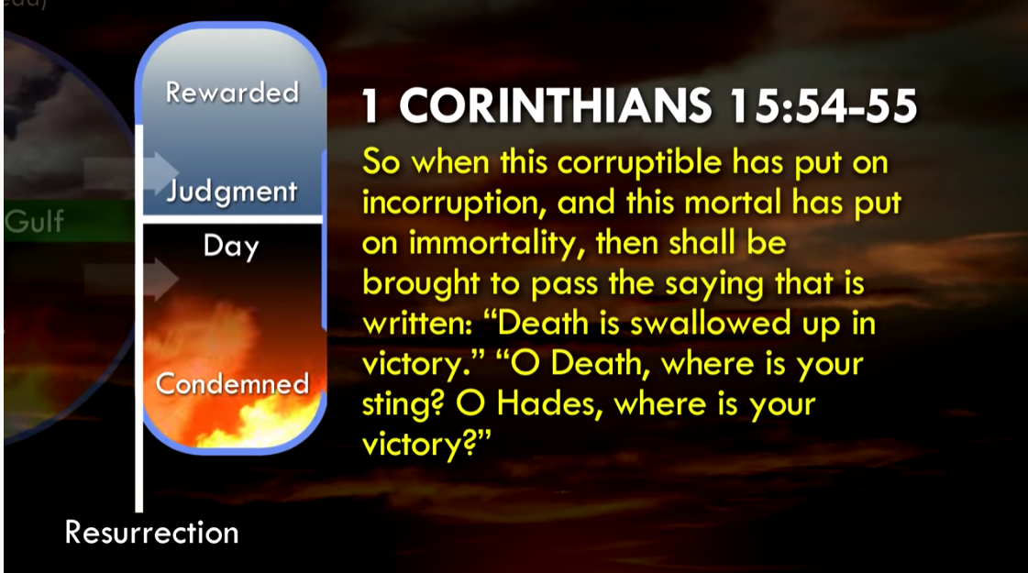
Notes:
Death and Hades will be overcome on that day
Both will come to an end on the day of judgment
Question?What happens to those of us who are still alive?
- the living will be changed into an incorruptible body

Slide 28
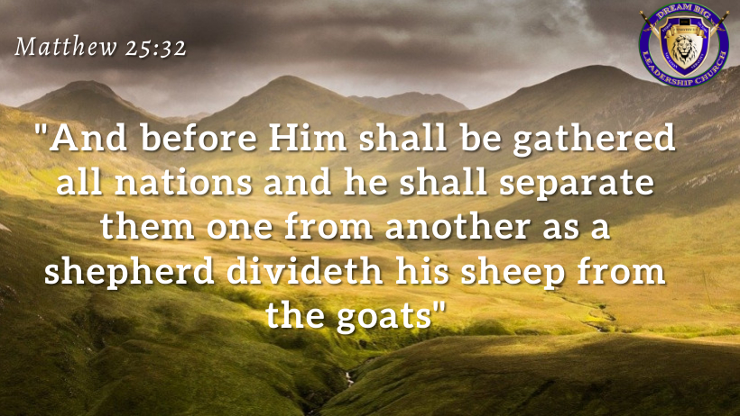
Notes:
All humanity will be gathered for judgment
, 2 Corinthians 5:10

Slide 29
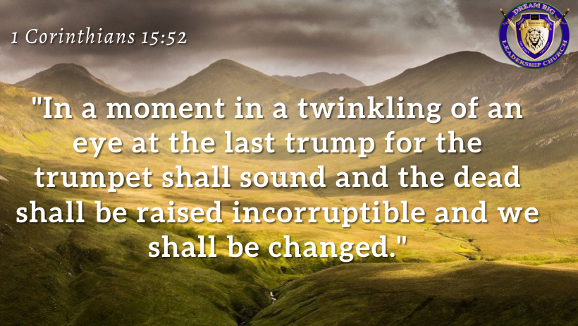

Slide 30
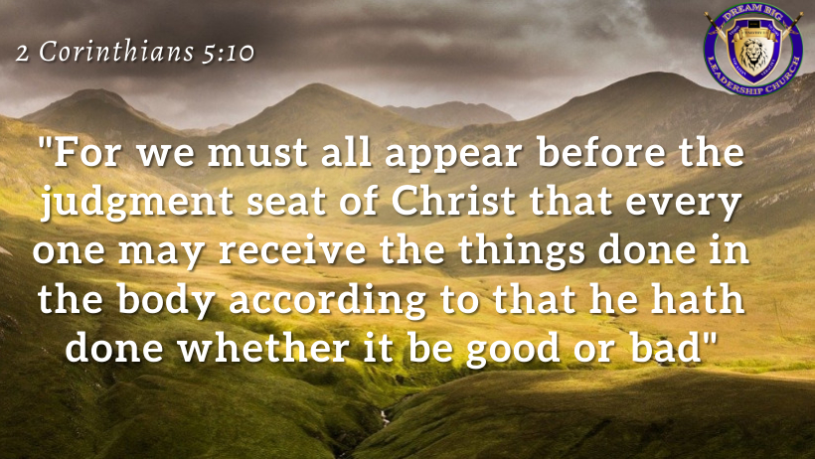
Notes:
Judgment Day – its not a trial, but more a pronouncement of judgment, sentencing

Slide 31
Why is judgment necessary
The last time people saw Christ he was dying on his cross

Slide 32
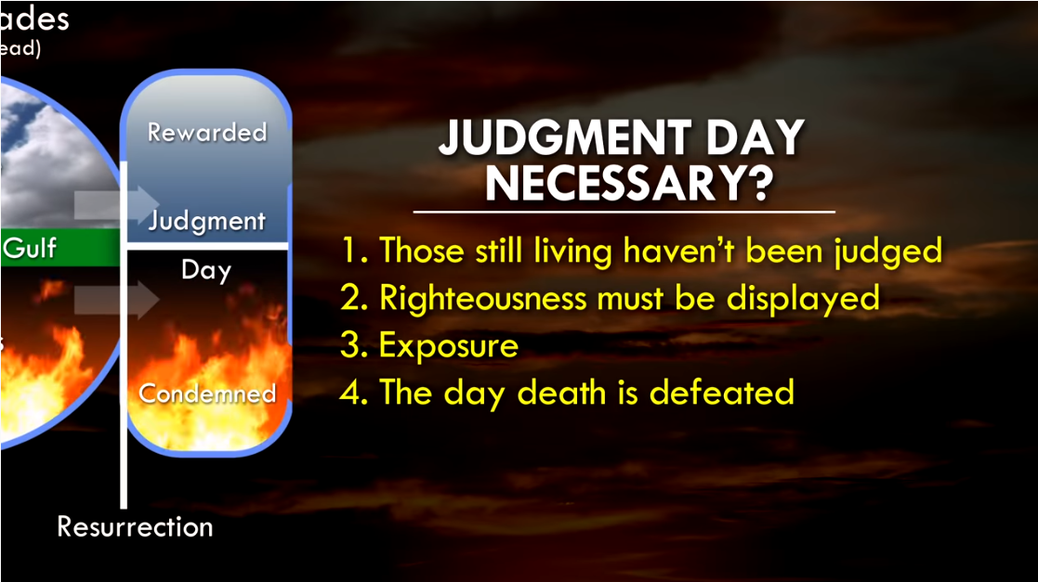

Slide 33
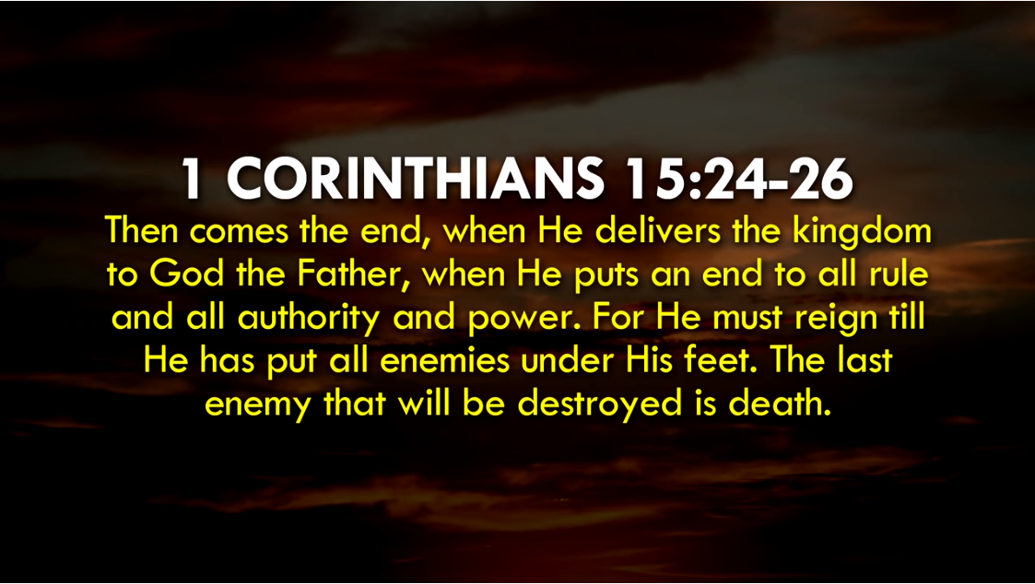

Slide 34
ETERNITY
Everlasting
Without end
Never to cease
Inderterminate as to duration

Slide 35
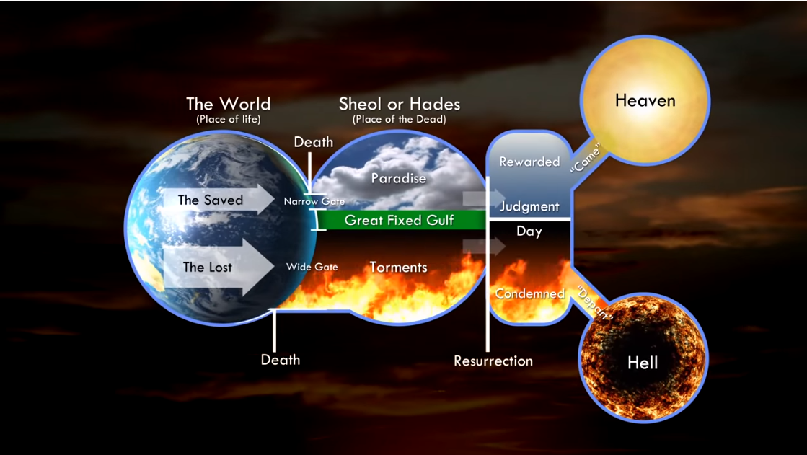

Slide 36
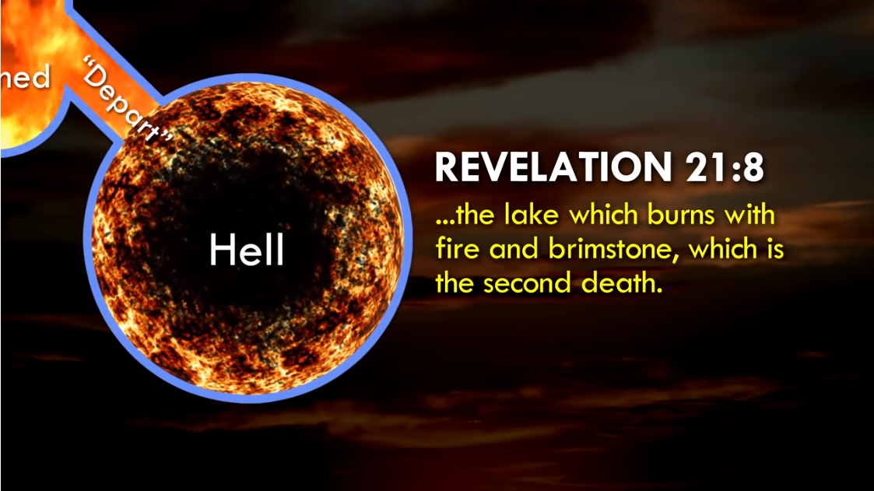
Notes:
How long will hell last? Revelation 14:11 – “And the smoke of their torment ascendeth forever and ever and they have no rest day or night…”

Slide 37
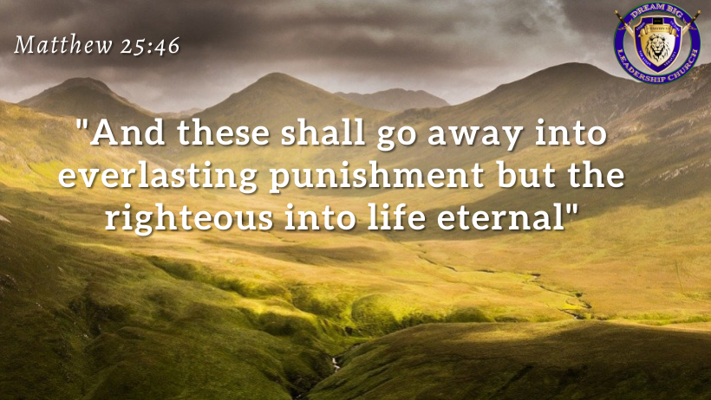

Slide 38
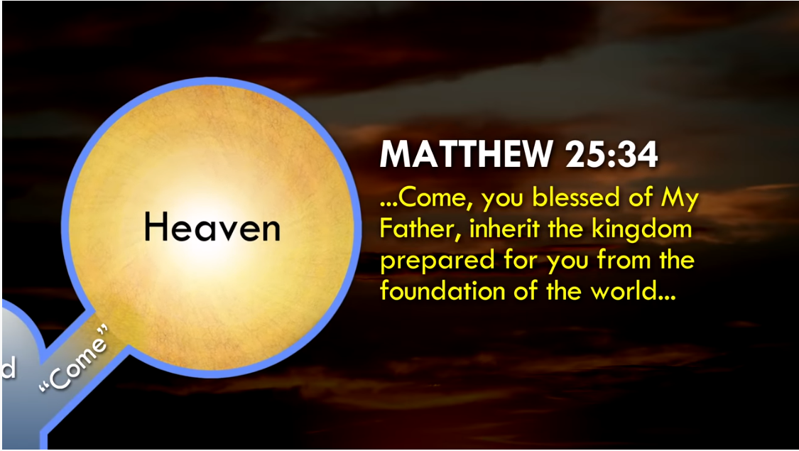

Slide 40
Eschatology timeline
1. Rapture – 1 Thess. 4:17
2. Great Tribulation - Dan. 9:27, matthew 24
3. 2nd Coming – Rev. 1:7, matthew 24:27
4. Battle of Armageddon - Rev. 16:12-16
5. The Millennium (satan bound in the beginning and released in the end) – revelation 20:4
6. New Heavens and New Earth – Rev. 21:1

Slide 41
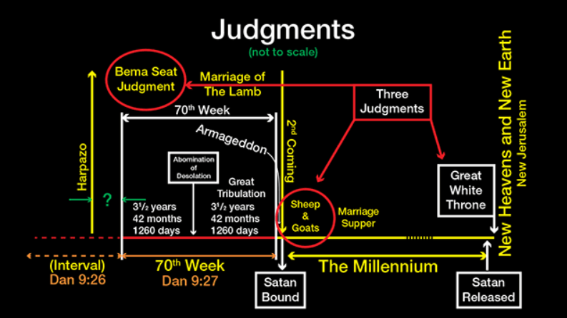
Notes:
1 Corinthians 15:41-58
John 14:1-3
1. Rapture 2. Great Tribulation 3. Battle of Armageddon 4. Second Coming of Christ 5. The Millenium 6. New Heavens and New Earth

Slide 42
The day of the lord (2 Thessalonians 2:3-8)
Apostasy (falling away)
(v.3)
The restrainer removed (v.3,8)
The man of sin revealed (v.8)
The Day of the Lord (v.3)
The Rapture
Notes:
1 Thessalonians 5:4 – a thief in the night

Slide 43
1. The Rapture (harpazo)
1 Thessalonians 4:17 – “Then we which are alive and remain shall be caught up (harpazo) together with them in the clouds to meet the lord in the air: and so shall we ever be with the lord.”

Slide 44
7 raptures
Enoch – genesis 5:42/ Hebrews 11:5
Elijah – 2 kings 2:1, 11
Jesus – mark 16:19, acts 1:9-11/ revelation 12:5
Phillip – acts 8:39
Paul – 2 Corinthians 12:2-4
Body of Christ – 1 Thessalonians 4:17
John – revelation 4:1

Slide 45
10 reasons we will be raptured before the tribulation
promise to be delivered from the hour of trial – revelation 3:10
WE are not the object of god’s wrath
We were promised to escape not endure – luke 21:36
Jesus said “look up” not “look out” – luke 21:28
During war ambassadors are called home first –
2 Corinthians 5:20

Slide 46
10 reasons we will be raptured before the tribulation
The restrainer will be removed before the antichrist comes – 2 Thessalonians 2:6
“In the twinkling of an eye” is not an extended event
“in the air” not the earth
The woman is Israel not the church – revelation 12:5
The marriage supper is in heaven and includes the raptured – revelation 19:11

Slide 47
2. The Great tribulation
Revelation 7:14 - And I said unto him, “Sir, thou knowest.” And he said to me, “These are they that came out of great tribulation, and have washed their robes and made them white in the blood of the Lamb.
Daniel 9:27 (AMP) - And he will enter into a binding and irrevocable covenant with the many for one week (seven years), but in the middle of the week he will stop the sacrifice and grain offering [for the remaining three and one-half years]; and on the wing of abominations will come one who makes desolate, even until the complete destruction, one that is decreed, is poured out on the one who causes the horror.”
Revelation 3:10 - Because thou hast kept the word of my patience, I also will keep thee from the hour of temptation, which shall come upon all the world, to try them that dwell upon the earth.

Slide 48
3. 2nd Coming
Revelation 1:7 - Behold, he cometh with clouds; and every eye shall see him, and they also which pierced him: and all kindreds of the earth shall wail because of him. Even so, Amen.
Matthew 24:27 - For as the lightning cometh out of the east, and shineth even unto the west; so shall also the coming of the Son of man be.

Slide 49
4. Battle of Armageddon
Revelation 16:16 – “And he gathered them together into a place called in the Hebrew tongue Armageddon.”
Revelation 16:14 - For they are the spirits of devils, working miracles, which go forth unto the kings of the earth and of the whole world, to gather them to the battle of that great day of God Almighty.
Revelation 17:14 - These shall make war with the Lamb, and the Lamb shall overcome them: for he is Lord of lords, and King of kings: and they that are with him are called, and chosen, and faithful.

Slide 50
5. The millennium
Revelation 20:1-8 - Then I saw an angel coming down from heaven, having the key to the bottomless pit and a great chain in his hand. 2 He laid hold of the dragon, that serpent of old, who is the Devil and Satan, and bound him for a thousand years; 3 and he cast him into the bottomless pit, and shut him up, and set a seal on him, so that he should deceive the nations no more till the thousand years were finished. But after these things he must be released for a little while.
The Saints Reign with Christ 1,000 Years
(4) And I saw thrones, and they sat on them, and judgment was committed to them. Then I saw the souls of those who had been beheaded for their witness to Jesus and for the word of God, who had not worshiped the beast or his image, and had not received his mark on their foreheads or on their hands. And they lived and reigned with Christ for [a]a thousand years. 5 But the rest of the dead did not live again until the thousand years were finished. This is the first resurrection. 6 Blessed and holy is he who has part in the first resurrection. Over such the second death has no power, but they shall be priests of God and of Christ, and shall reign with Him a thousand years.

Slide 51
5. The millennium (contd.)
Satanic Rebellion Crushed
7 Now when the thousand years have expired, Satan will be released from his prison 8 and will go out to deceive the nations which are in the four corners of the earth, Gog and Magog, to gather them together to battle, whose number is as the sand of the sea. 9 They went up on the breadth of the earth and surrounded the camp of the saints and the beloved city. And fire came down from God out of heaven and devoured them. 10 The devil, who deceived them, was cast into the lake of fire and brimstone where[b] the beast and the false prophet are. And they will be tormented day and night forever and ever.

Slide 52
New heavens and the new earth
Revelation 21:1-7 - And I saw a new heaven and a new earth: for the first heaven and the first earth were passed away; and there was no more sea. 2 And I John saw the holy city, new Jerusalem, coming down from God out of heaven, prepared as a bride adorned for her husband. 3 And I heard a great voice out of heaven saying, Behold, the tabernacle of God is with men, and he will dwell with them, and they shall be his people, and God himself shall be with them, and be their God. 4 And God shall wipe away all tears from their eyes; and there shall be no more death, neither sorrow, nor crying, neither shall there be any more pain: for the former things are passed away. 5 And he that sat upon the throne said, Behold, I make all things new. And he said unto me, Write: for these words are true and faithful. 6 And he said unto me, It is done. I am Alpha and Omega, the beginning and the end. I will give unto him that is athirst of the fountain of the water of life freely. 7 He that overcometh shall inherit all things; and I will be his God, and he shall be my son.

Slide 53
3 judgments
Bema Seat
2 Corinthians 5:10 - For we must all appear before the judgment seat of Christ; that every one may receive the things done in his body, according to that he hath done, whether it be good or bad.
Romans 14:10 - But why dost thou judge thy brother? or why dost thou set at nought thy brother? for we shall all stand before the judgment seat of Christ.
Great White Throne Judgment
Revelation 20:11-15 - 11 And I saw a great white throne, and him that sat on it, from whose face the earth and the heaven fled away; and there was found no place for them. 12 And I saw the dead, small and great, stand before God; and the books were opened: and another book was opened, which is the book of life: and the dead were judged out of those things which were written in the books, according to their works. 13 And the sea gave up the dead which were in it; and death and hell delivered up the dead which were in them: and they were judged every man according to their works. 14 And death and hell were cast into the lake of fire. This is the second death. 15 And whosoever was not found written in the book of life was cast into the lake of fire.
Judgement of the Sheep and the Goats
Matthew 25:31-22 - 31 When the Son of man shall come in his glory, and all the holy angels with him, then shall he sit upon the throne of his glory: 32 And before him shall be gathered all nations: and he shall separate them one from another, as a shepherd divideth his sheep from the goats: 33 And he shall set the sheep on his right hand, but the goats on the left.

Slide 54
Marriage supper of the lamb
Revelation 19:7-9 – “let us be glad and rejoice, and give honour to him: for the marriage of the Lamb is come, and his wife hath made herself ready.” 8 And to her was granted that she should be arrayed in fine linen, clean and white: for the fine linen is the righteousness of saints. 9 And he saith unto me, Write, Blessed are they which are called unto the marriage supper of the Lamb. And he saith unto me, These are the true sayings of God.

